Slide 1
Relations and Functions
Joseph Cijo
2022A7PS0019U

Slide 2
Topics
What are Relations?
What are Functions?
What defines a Relation?
Practical Applications

Slide 3
What are Relations?
Topic 1

Slide 4
What are Relations?
Relations refer to a basic idea that specifies how two groups of items are connected to one another.
Represented as a collection of ordered pairs, each of which has two items, one from each of the two sets.
Frequently used to describe links, correlations, or comparisons between set items.

Slide 5





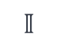
What are Relations?
$$ℕ$$
$$ℂ$$
$$ℤ$$
$$ℚ$$
$$ℝ$$
$$𝕀$$
Commonly used in
Set Theory
Graph Theory
Algebra
Topology

Slide 6
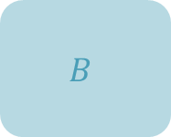
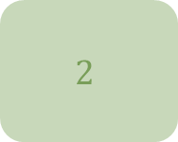
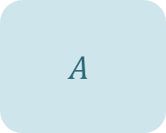
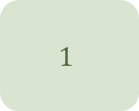






What are Relations?
$$\text{Domai}\text{n}$$
$$\text{Range}$$
$$1$$
$$A$$
$$2$$
$$B$$
$$3$$
$$C$$
$$4$$
$$D$$

Slide 7



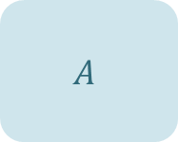
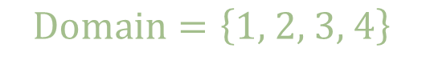
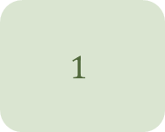






What are Relations?
$$\text{Domain}$$
$$\text{Range}$$
$$1$$
$$A$$
$$\text{Domain}=\left\{\text{1, 2, 3, 4}\right\}$$
$$2$$
$$B$$
$$\text{Range}=\left\{A, B,C, D\right\}$$
$$\text{Relations}=\left\{\left(1, B\right), \left(2,C\right),\left(3,D\right), (4,A)\right\}$$
$$3$$
$$C$$
$$4$$
$$D$$

Slide 8
What are Functions?
Topic 2

Slide 9
What are Functions?
Functions are a specific form of relationship between two sets, which are commonly referred to as the domain and the codomain.
Assigns each domain element to exactly one codomain element.
Is critical in many areas of mathematics, science, and engineering.

Slide 10
What are Functions?
They are essential for studying rates of change, solving equations, and analyzing data in calculus, algebra, and other fields of mathematics.
Functions are a central concept for understanding how variables ‘relate’ to one another as well as for generating predictions and computations in a variety of domains.

Slide 12
Chart

Slide 13
Table
 | Category 1 | Category 2 | Category 3 | Category 4
Item 1 | 4.5 | 2.3 | 1.7 | 5
Item 2 | 3.2 | 5.1 | 4.4 | 3
Item 3 | 2.1 | 1.7 | 2.5 | 2.8
Item 4 | 4.5 | 2.2 | 1.7 | 7

Slide 14

The way to get started is to quit talking and begin doing.
Walt Disney

Slide 15
Team
Name Title
Name Title
Name Title
Name Title

Slide 16
Timeline
To start a presentation, go to the Slide Show tab, and select From Beginning.
1
To display Presenter view, in Slide Show view, on the control bar at the bottom left select the three dots, and then Show Presenter View.
2
During your presentation, the speaker notes are visible on your monitor, but aren't visible to the audience.
3
The Notes pane is a box that appears below each slide. Tap it to add notes.
4
If you don’t see the Notes pane or it is completely minimized, click Notes on the task bar across the bottom of the PowerPoint window.
5

Slide 17
Content
Subtitle
Subtitle
Add text, images, art, and videos.
Add transitions, animations, and motion.
Save to OneDrive, to get to your presentations from your computer, tablet, or phone.
Open the Design Ideas pane for instant slide makeovers.
When we have design ideas, we’ll show them to you right there.

Slide 18
Content
Subtitle
Subtitle
Subtitle
Add text, images, art, and videos.
Add transitions, animations, and motion.
Save to OneDrive, to get to your presentations from your computer, tablet, or phone.
Open the Design Ideas pane for instant slide makeovers.
When we have design ideas, we’ll show them to you right there.
This PowerPoint theme uses its own unique set of colors, fonts, and effects to create the overall look and feel of these slides.
PowerPoint has tons of themes to give your presentation just the right personality.

Slide 19

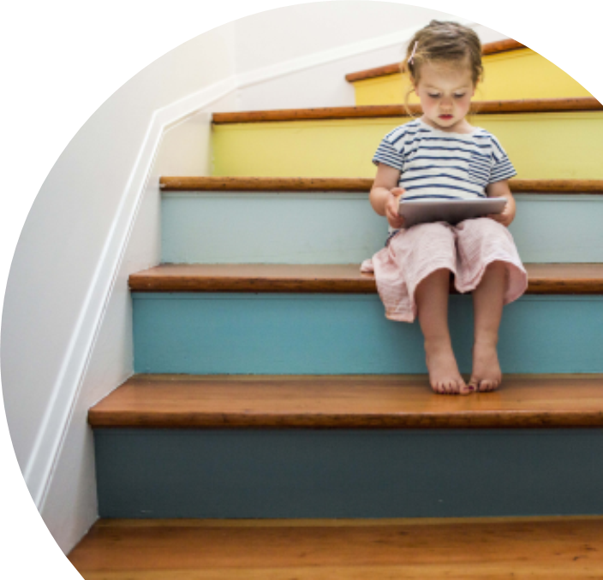
Summary
With PowerPoint, you can create presentations and share your work with others, wherever they are. Type the text you want here to get started. You can also add images, art, and videos on this template. Save to OneDrive and access your presentations from your computer, tablet, or phone.

Slide 20
Thank you
Presenter name
Email address
Website

